Slide 1

Sakai Racing Team
www.dr-chuck.com/racing/

Slide 2
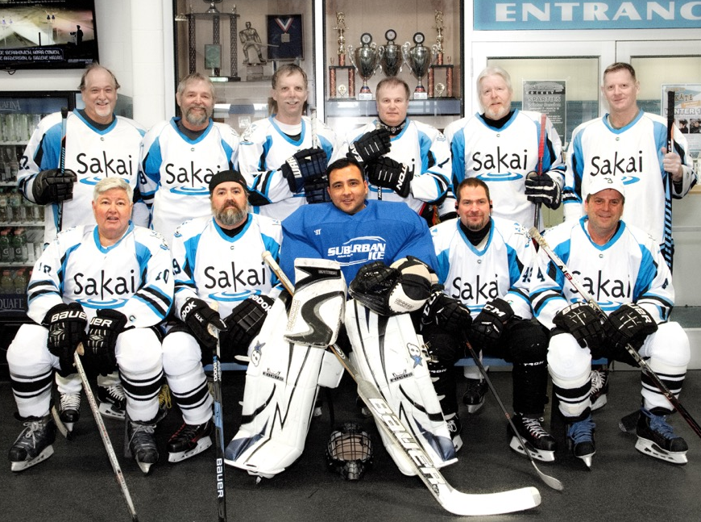
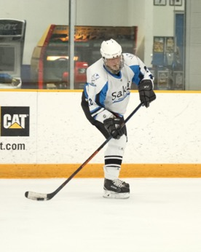
https://goo.gl/7i6GwA
Notes:
towards the end of winter in the United States it is hockey playoff time including the Sakai/Apereo Hockey Team

Slide 3
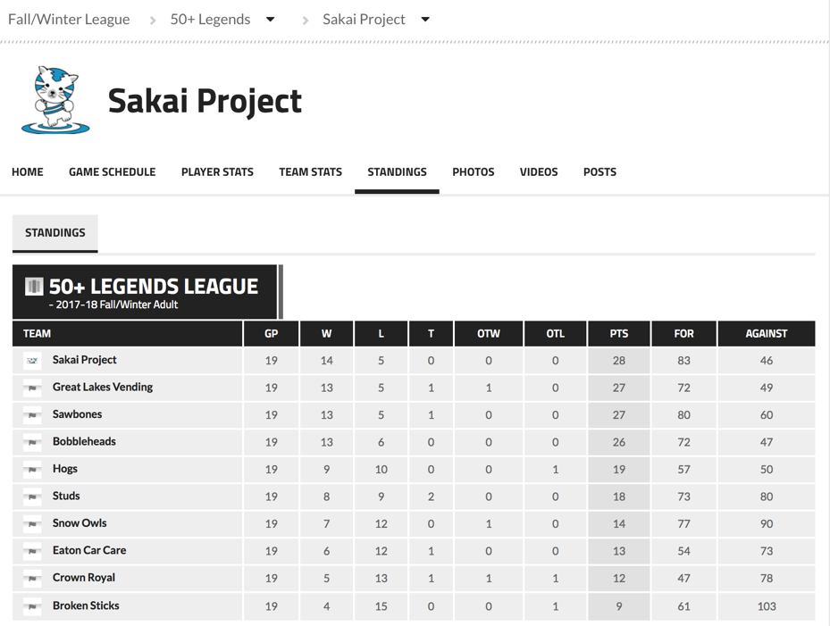
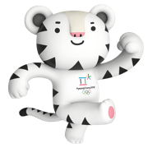
2018-19 Two Teams!
Notes:
Who happen to be in first place in the 50 and over league…

Slide 4


Slide 5
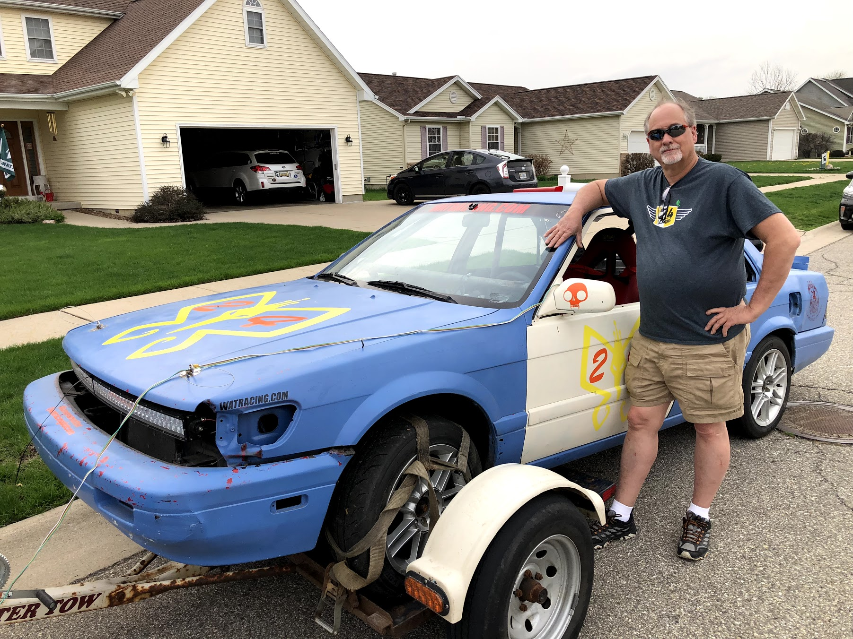
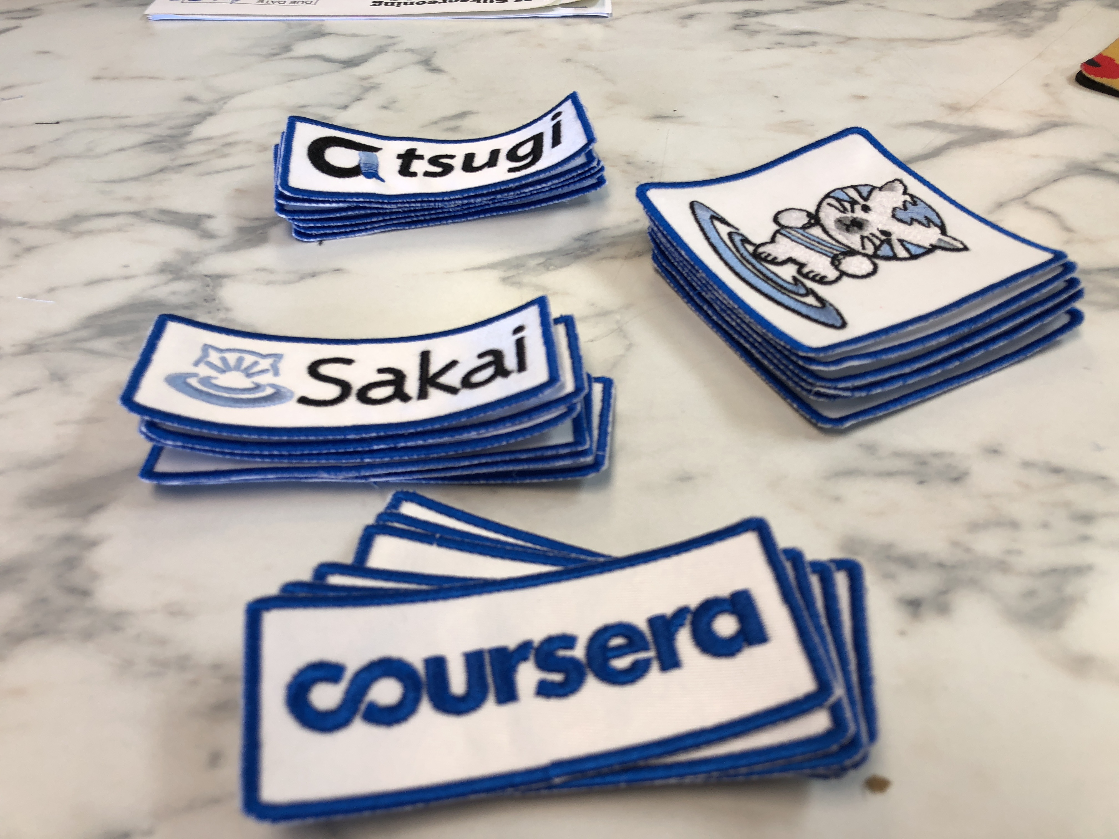
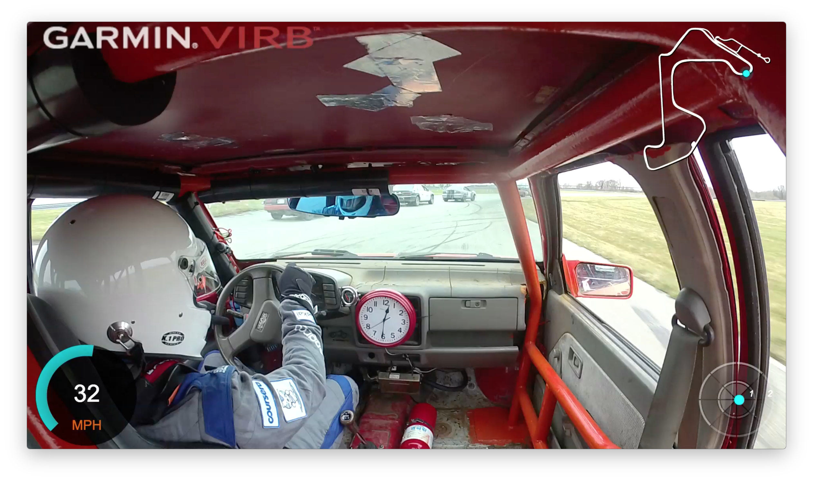
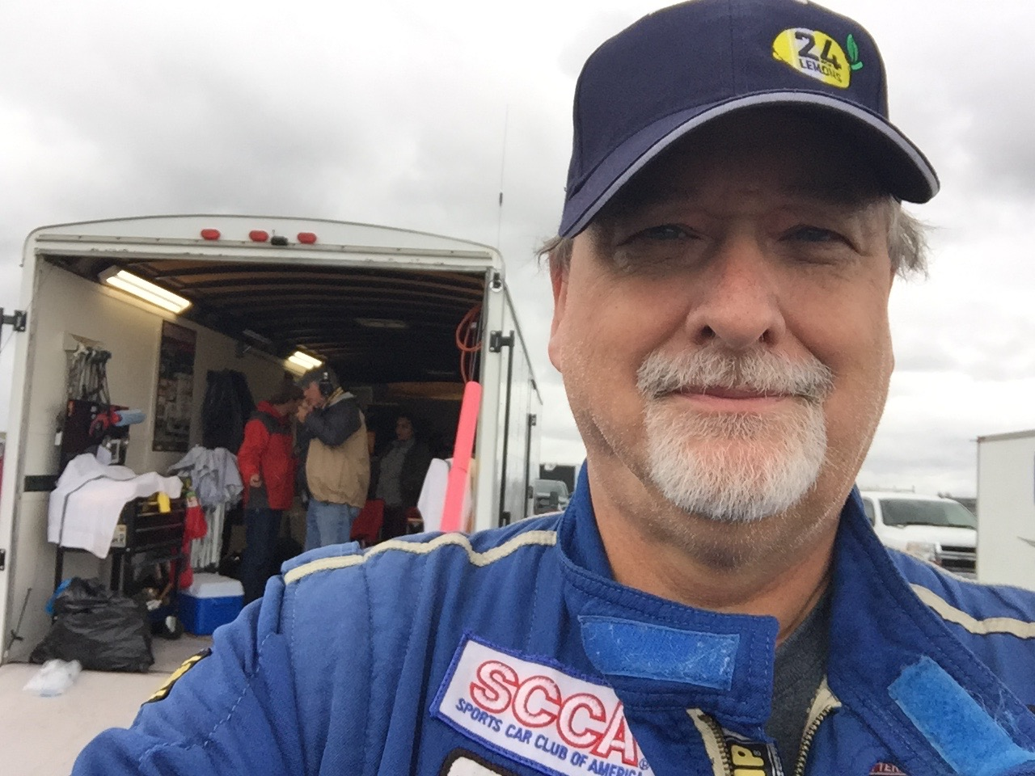

www.dr-chuck.com/racing
www.24hoursoflemons.com

Slide 6
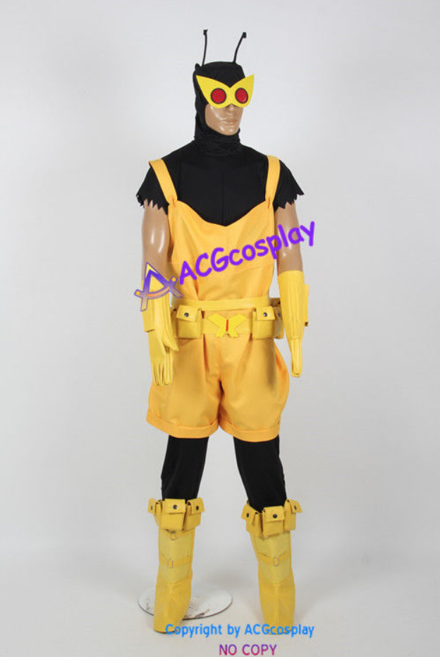


Slide 7


Upcoming Races
Gingerman Raceway, South Haven, MI
June 30-July 1
October 13-14

